Slide 1
Common Framework of Sustainable Finance Taxonomies for Latin America and the Carribbean
Working Group on Sustainable Finance Taxonomies of Latin America and the Caribbean
Interagency Technical Committee - Forum of Ministers of Environment of Latin America and the Caribbean
10th July 2023

Slide 2
01
State of play

Slide 3
Taxonomies are being developed globally at a rapid pace
Kazakhstan
More than
35
taxonomy projects worldwide, hence the importance
of interoperability
Rusia
United Kingdom
Canada
European
Union
Mongolia
Georgia
South Corea
Serbia
China
Egypt
Hong Kong
Mexico
Dominican Republic
UAE
India
Vietnam
Central America
Philippines
Senegal
Sri Lanka
Sustainable Taxonomy:
Colombia
Rwanda
Indonesia
Bangladesh
Peru
Brazil
Thailand
Existing
New Zealand
South Africa
Malaysia
Developing
Chile
Singapore
Private sector initiative
Source: UNEP FI, 2023

Slide 4
02
Working Group on Sustainable Finance Taxonomies in LAC

Slide 5
Working Group on Sustainable Finance Taxonomies in LAC¹
Objective
Created as part of the Interagency Technical Committee (ITC) of the Forum of Ministers of Environment of LAC with the aim of promoting regional dialogue to support LAC member states in developing sustainable finance frameworks that are interoperable across LAC jurisdictions and internationally, while considering local specificities
¹ UNEP, and its Finance Initiative (UNEP FI), UNDP, IFC, IDB, CAF, ECLAC FAO, the staff of the International Monetary Fund (IMF) and the World Bank and the European Commission

Slide 6
Common Framework of Sustainable Finance Taxonomies for LAC
03

Slide 7
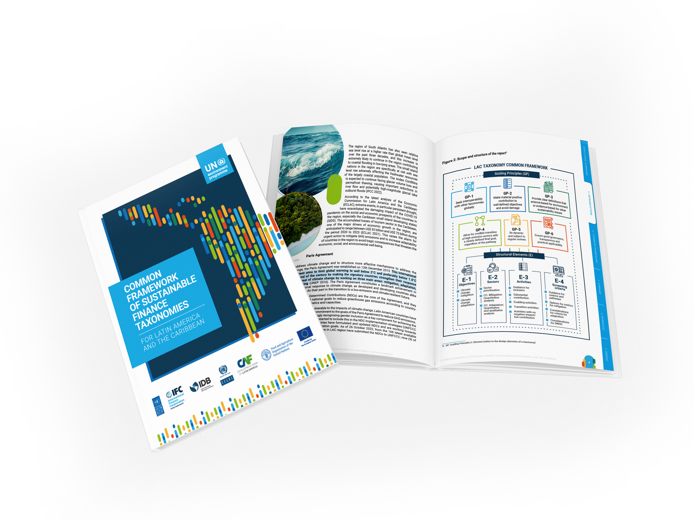
Common Framework of Sustainable Finance Taxonomies for LAC
Is a guidance document that can serve as a voluntary reference to orient LAC member states that are in the process of or intend to develop sustainable finance taxonomies;
Establishes a set of guiding principles that will improve comparability and ensure interoperability of sustainable finance taxonomies in LAC & internationally;
Focuses on climate change objectives; prioritizes sectors that are important to these objectives for the LAC region
1.
2.
3.

Slide 8
Methodology and process
WE ARE HERE
5. Expert Consultation LAC Taxonomy Common Framework
3. First draft LAC Taxonomy Common Framework
Deliverable 5: Incorporation of comments of the expert consultation
07
06
Deliverable 3: development of the common taxonomy framework, considering current developments, stakeholder engagement
and research conducted.
2. Current status of green taxonomies
05
6. Final Report
Deliverable 6: Finalization of the LAC Taxonomy framework, incorporating feedback from stakeholders.
Deliverable 2: Research on the current state of development of green taxonomies in LAC and globally.
04
03
March 2022
02
4. Second draft LAC Taxonomy Common Framework
7. Publication
Publication of the report by the LAC Taxonomy Working Group
01
Deliverable 4: Review the LAC Taxonomy Common Framework with relevant parties and incorporate comments.
July 10, 2023
1. Inception report
Deliverable 1: Development of the project work plan and methodology.

Slide 9
Main foundations
Scope
Harmonization and interoperability
Selected objectives
Aligned with regional work
The framework considers the work already done or is in progress with respect to frameworks for sustainable finance
The framework is armonized with other internationa taxonomies
Climate change mitigation
Adaptation to climate change
Other environmental and social objectives (future phases)
Inclusive
Science-based
The framework considers the diversity among countries in the region
The framework is based on scientific principles and helps avoid greenwashing
Decarbonization trajectory
The framework helps economic sector achieve decarbonization in-line with the Paris Agreement goals

Slide 10
Common Framework of Sustainable Finance Taxonomies for LAC
Guiding Principles
GP-1
GP-3
Seek interoperability with other regional and global taxonomies
Clear definitions that are science-based for the environment or evidence-based for other sustainability issues
GP-5
Dynamic and subject to regular reviews
GP-2
GP-4
GP-6
Material positive contribution to well-defined objectives and avoid damage
Credible transition of high-emission sectors with a clearly defined final goal, regardless of the pathway
Ensure adequate governance, transparency, and practical applicability (usability)
Structural elements
1.
2.
3.
4.
Objective
Sectors
Activities
Screening Criteria
Helps define the ambition, selection, activities, and screening criteria
Economic sectors for which activities are selected
and defined
Economic activities under the selected sectors for which definitions and eligibility criteria are developed
Metrics and thresholds which determine the eligibility of an economic activity under the taxonomy

Slide 11
Technical guidance for the framework
04

Slide 12
Structural element 2: Economic sectors
Prioritized sectors: Climate change mitigation and adaptation
Section | Name
A | Agriculture, forestry, and fishing
B | Mining and quarrying
C | Manufacturing
D | Electricity, gas, steam, and air conditioning supply
E | Water supply; sewerage, waste management and remediation activities
F | Construction
H | Transportation and storage
J | Information and communication
K | Financial and insurance activities
L | Real estate activities
M | Professional, scientific, and technical activities
N | Administrative and support services
P | Education
Q | Human health and social work activities

Slide 13
Structural element 3: Economic activities
Guidance for inclusion
Make a substantial contribution based on their own performance
E.g., electricity generation through solar PV technologies is an activity with a direct substantial contribution to climate change mitigation.
Eligibility criteria of the activities will help determine the substantial contribution.
E.g., hydropower plants with a power density greater than 5 W/m2
Help with decarbonization or improving adaptability to climate change.
Substantially contribute towards the
taxonomy objectives
Substantial contribution

Slide 14
Structural element 3: Economic activities
Guidance for inclusion
Has a substantial & positive environmental impact, based on life-cycle considerations and;
Does not lead to a lock-in of assets that undermine long-term environmental goals, considering the economic lifetime of those assets.
E.g., Manufacturing activities of low-carbon technologies, manufacturing low-carbon TIC, construction of dikes in coastal areas to prevent the risk of flooding of urban infrastructures.
Enable other activities in the same sector or other sectors to meet taxonomy objectives
Enabling

Slide 15
Structural element 3: Economic activities
Guidance for inclusion
Activities with no possible technological pathways for significantly improving their performance and hence needs to be phased out (e.g., decommissioning of fossil fuel plants)
Activities that have potential technological pathways for significantly improving their performance and needs to be transitioned urgently to prevent negative damage (e.g., activities of high emission manufacturing processes: cement, chemicals, iron & steel)
Must go through a transition to eventually meet the taxonomy ambition over a defined period
Transition

Slide 16
Structural element 3: Economic activities
Guidance for inclusion
Do not make a substantial contribution to any of the taxonomy objectives but neither cause negative damage
Can have a low contribution to the taxonomy objectives and cannot be labelled as green but are essential to support the economy decarbonization
E.g., activities in sectors such as engineering & architecture services undertaken in relation to the taxonomy objectives should be considered for inclusion in the taxonomy
Do not have a significant contribution but have a low or minimal contribution to the taxonomy objectives and do not cause harm
Activities with min. performance

Slide 17
Structural element 3: Economic activities
Non-aligned economic activities
1.
Activities that hinder the transition of other activities (e.g., including fossil fuel-based passenger transportation when a viable decarbonized mode, such as electric vehicles or other low-carbon transportation systems, is available)
2.
Activities that do not have a viable transition pathway to achieve the ambition of the taxonomy in a defined time period (e.g., new coal plants that cannot decarbonize to achieve net zero emissions in 2050 through their own performance)
3.
Activities that definitely harm or cause a negative contribution to any of the taxonomy objectives.

Slide 18
Structural element 4: Eligibility criteria
Guidance for metrics and pathways for some sectors with high GHG emissions
Mitigation metrics options for key sectors
Considerations for adaptation criteria for key sectors
Do No Significant Harm Considerations (DNSH)
Pathways for eligibility criteria for the prioritized sectors (Vias, why? what do you need to apply?)
Example: Sector - Water
Option-1: Energy efficiency or GHG reduction indicators
Option-2: Water losses and leakage indices
Option-3: Percentage of water savings
Option-4: List of requirements to ensure process efficiency and reduce GHG emissions
Option-5: Vulnerability and risk assessments (adaptation)

Slide 19
Example – Sector: Water supply; sewerage, waste management and remediation activities
05

Slide 20
Sector: Water supply, sewerage, waste management and remediation activities
Ambition
The ambition of the sector should be to ensure the following:
Efficient and resilient water supply and sanitation systems
Improve access to safe potable water and sanitation
Efficient and resilient collection, distribution, and treatment systems
Efficient management of water resources
Protection of aquifers, catchments, river basins, and ecosystems
Metrics
Option-1 Energy efficiency or GHG reduction indicators
Option-2 Water losses and leakage indices
Option-3 Percentage of water savings
Option-4 List of requirements to ensure process efficiency
Option-5 Vulnerability and risk assessments.

Slide 21
Sector: Water supply, sewerage, waste management and remediation activities
Option-1: Energy efficiency or GHG reduction indicators
Information necessary to choose the option
Baseline data of energy consumption or GHG emissions of the top-class efficient systems
Energy efficiency data for individual processes (e.g., water treatment and distribution)
Advantages:
Disadvantages:
Thresholds will be directly linked to GHG reductions
Easy to monitor progress and establish declining thresholds
The metric is not applicable to all utility companies and systems because energy efficiency or GHG reduction is not always used as an indicator to measure efficiencies
Efficiencies may depend on geography (e.g., mountainous regions require more energy to pump water compared to flat regions)

Slide 22
Sector: Water supply, sewerage, waste management and remediation activities
Option-2: Water losses and leakage indices
Information necessary to choose the option
Baseline data of losses of water utility companies and distribution networks
Availability of methodologies or standards to measure leakage data
Advantages:
Disadvantages:
Positive impact on water resources and reduces wastage
Acts as an indirect measurement of system efficiency and GHG emissions
Measuring such indicators can lead to increased maintenance and operations costs, especially in existing systems due to the necessity of implementation of monitoring systems
Difficult to detect and minimize leaks in large distribution networks

Slide 23
Sector: Water supply, sewerage, waste management and remediation activities
Option-3: Percentage savings of water consumption
Information necessary to choose the option
Baseline data of water consumption that helps determine the water savings threshold
Adequate information to determine reduction goals across sectors and activities (e.g., water consumption data for buildings, industrial processes, irrigation, etc.)
Advantages:
Disadvantages:
Easy to implement
Ensures promotion and development of new technologies that are efficient
Difficult to define reduction targets when there is no baseline data available
Reduction goals may vary for different activities (e.g., agriculture, buildings, textile industry, etc.)

Slide 24
Sector: Water supply, sewerage, waste management and remediation activities
Option-4: List of requirements to ensure process efficiency
Information necessary to choose the option
Information about current practices and technologies for economic activities
Information about the impact of processes on climate change mitigation and adaptation (e.g., GHG reduction due to anaerobic digestion of sewage sludge, flood defence systems for coastal infrastructure)
Refences and benchmarks (e.g., treated water discharge limits)
Local context for including the activities (e.g., information about the common processes and practices in the country)
Advantages:
Disadvantages:
Does not consider process efficiencies of activities
Risk of implementation of low-quality technologies
Easy to implement
No data is required for establishing thresholds
Substantial contribution is implicit

Slide 25
Sector: Water supply, sewerage, waste management and remediation activities
Option-5: Vulnerability and risk assessments
Information necessary to choose the option
Catchment, river basin, aquifer, topography, and hydrological data
Information about ecosystems and settlements that are affected by the activity
Information on governance and water allocation
Climate and hydrological models
Risk assessment due to different climate events
Advantages:
Disadvantages:
Time consuming
Difficulty in obtaining required data for the assessments
Requires specialists to conduct such assessments
Vulnerability assessments can be expensive
Can be difficult for small users and projects
Detailed assessment that can help plan resilient systems
Considers all potential climate events and reduces risks to the assets
Typically considers long-term resilience for infrastructure
Positive impact on society and reduction of economic losses

Slide 26
Sector: Water supply, sewerage, waste management and remediation activities
Considerations to avoid harm to other objectives
Avoid damage to other environmental objectives, especially pollution and protection of water resources
Wastewater treatment and proper discharge to avoid downstream contamination
Sludge management and prevention of contamination to soil due to its application
Proper handling of lubricants, oils and other hazardous waste generated in the operation of treatment systems
Proper disposal of separated waste from sewer networks and wastewater treatment plants
Prevention of methane leakage (for treatment using anaerobic systems)

Slide 27
Sector: Water supply, sewerage, waste management and remediation activities
Climate change adaptation
Preference for nature-based solutions (e.g., Sustainable drainage systems (SuDS)
Protection of nature and natural capital (e.g., wetlands, mangroves)
Protection and effective management of watersheds and aquifers (e.g., groundwater protection and allocation)
Promotion of blue and green infrastructure (e.g., bioswales and green urban spaces)
Improvement of stormwater drain capacities, especially for urban infrastructure
Water management and storage (e.g., reservoirs)
Monitoring and meteorological systems (e.g., for monitoring weather events)
Resilience of potable and wastewater infrastructure, among others

Slide 28
06
Next steps

Slide 29
2023/2024 Workplan
Provide policy advice to LAC policymakers, financial supervisors and regulators, and central banks that are developing their taxonomies and disclosure frameworks on how to use the LAC Taxonomy Common Framework (the importance of interoperability);
Increase the scope of the current Common Framework of Sustainable Finance Taxonomies to other environmental objectives (eg. Biodiversity, circular economy, water conservation, among others)
1.
2.
3.
4.
Capacity building and dissemination activities for LAC policymakers, financial supervisors and regulators, and central banks on sustainable finance taxonomies and disclosures frameworks, includes an interoperability module based on the use of the LAC Taxonomy Common Framework
Organize high-level policy dialogues: Roadmap through 2023 to COP28 - from a technical work (LAC Taxonomy Common Framework) towards a regional political endorsement.
Notes:
What I am going to share with you is where we are in this process and what is next – Well, in the following weeks, we will publish the LAC Taxonomy Framework. We are currently planning the launch event.
And What is next? Once the LAC Taxonomy Common Framework is published, we are planning to:
Provide policy advise to LAC policymakers, financial supervisors and regulators, and central banks that are developing or planning to develop their taxonomies on how to use the LAC Taxonomy Common Framework (highlighting the importance of interoperability, while considering the local context);
Increase the scope of the current Common Framework of Sustainable Finance Taxonomies to other environmental objectives (eg. Biodiversity, circular economy, or water conservation)

Slide 30
Thank you!
Mercedes G. Fariña
LAC Policy Lead, UNEP FI
Vishwas Vidyaranya
Senior Taxonomy Specialist
ambireglobal.com

Slide 31
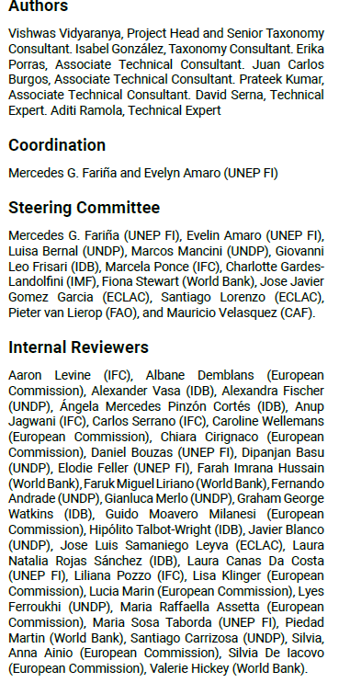
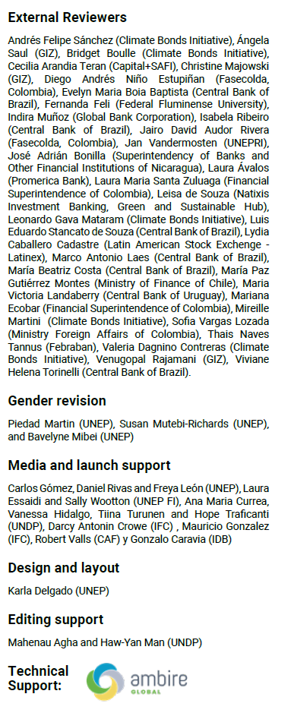
Thank you!
ambireglobal.com

Slide 32
Common Framework of Sustainable Finance Taxonomies for LAC
IS/Covered in scope | IS NOT/Not covered
Set of principles and framework for national and regional taxonomies in LAC | Not a regional taxonomy
Focused on objectives of climate change mitigation and climate change adaptation | The other environmental and social objectives will be developed in future. However, guidance has been provided from a DNSH perspective and minimum social safeguards
Provides an assessment and prioritisation of key economic sectors | Does not select sectors or activities for national taxonomies
Provides guidance on selection of activities | Does not establish metrics or thresholds for taxonomies
Provides guidance on methodologies for selection of metrics for defining screening criteria | Does not establish metrics or thresholds for taxonomies
Provides guidance on process of taxonomy development and governance structures | Does not prescribe processes or governance structures for LAC countries

